Slide 1
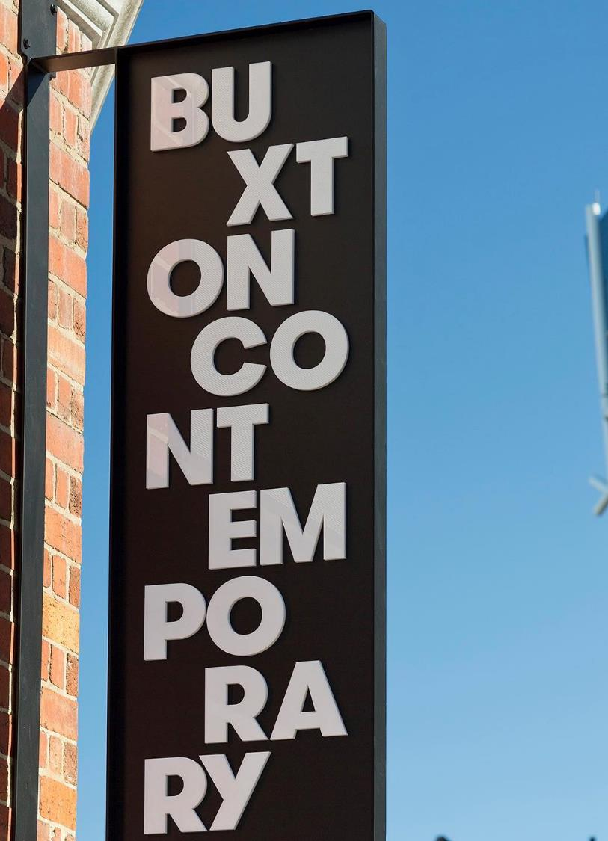
Buxton Contemporary

Slide 2
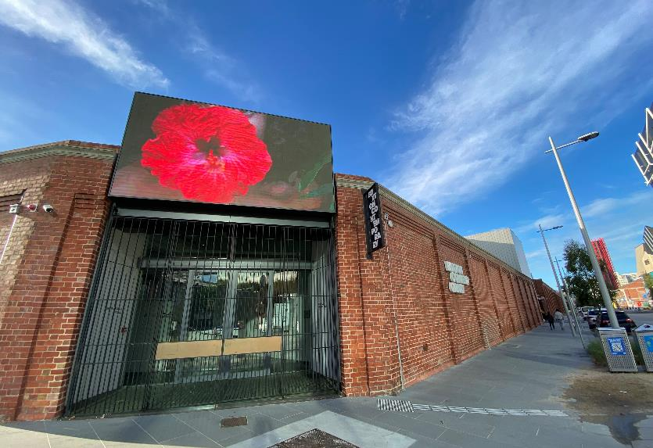
Buxton Contemporary is an art museum that holds exhibitions. It’s free to go to Buxton Contemporary and I don’t need a ticket.

Slide 3
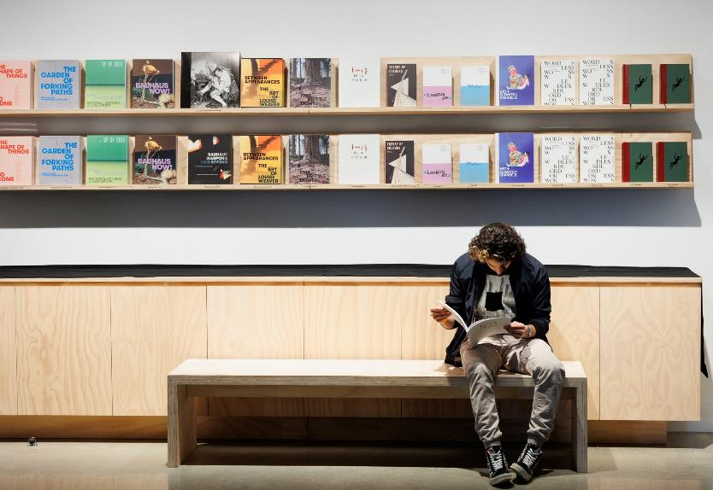
The exhibitions at Buxton Contemporary change every six months. Sometimes the exhibitions can cover confronting topics.
I can look at the Buxton Contemporary website to see what exhibitions are on.

Slide 4
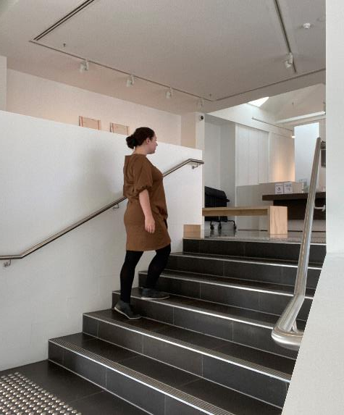
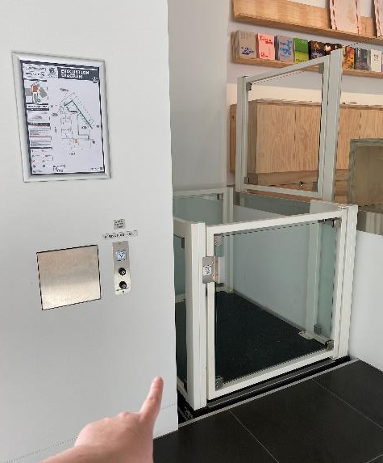
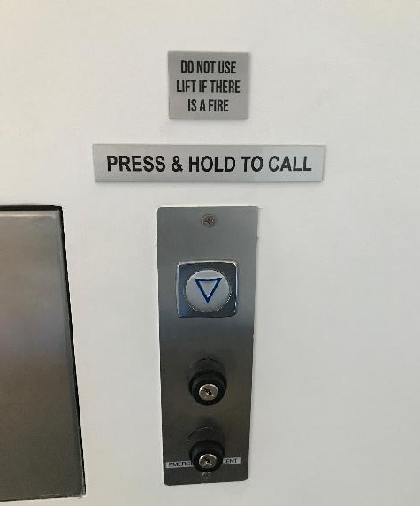
To enter Buxton Contemporary, I can use a small staircase. I can also use an accessibility lift.
The accessibility lift only fits one person at a time. I won't be able to operate the lift by myself because the button is too far away. I will need another person to press the button for me. If I am alone, I can ask a staff member to help me use the lift.

Slide 5
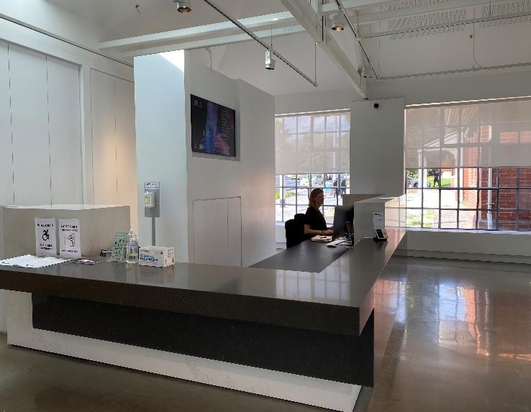
Once I enter Buxton Contemporary I will be in the foyer. This is where the front desk is.
A staff member at the desk will tell me what exhibitions are on right now. I will need to leave any food or drink I have with them, but I can keep my water with me.

Slide 6
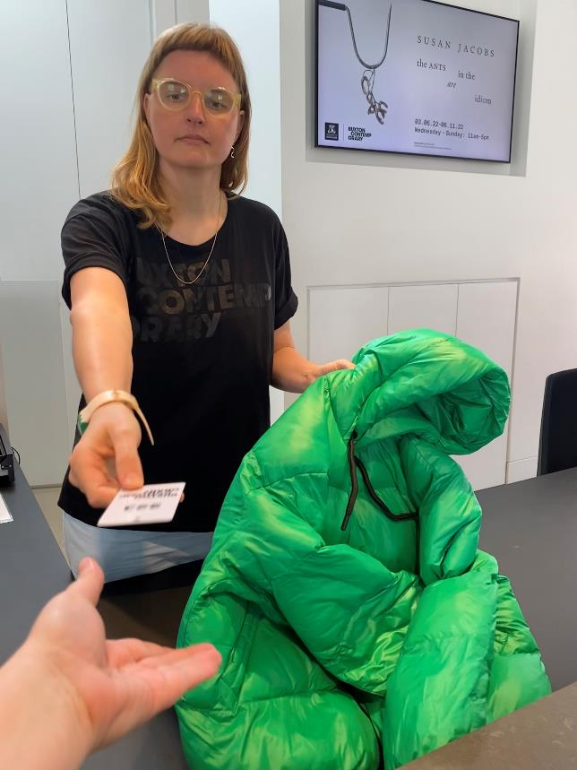
A staff member will ask me if I want them to look after my bag and coat while I'm at Buxton Contemporary.
I can say no if I want to keep my coat with me. I will need to cloak large bags and backpacks.
If I say yes, they will give me a ticket to keep while I am there.
When I leave, I can show the staff member at the desk my ticket and they will give my bag and coat back.

Slide 7
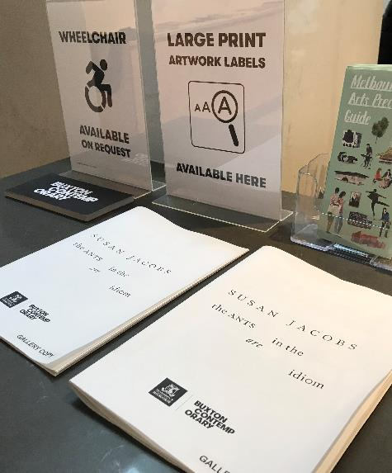
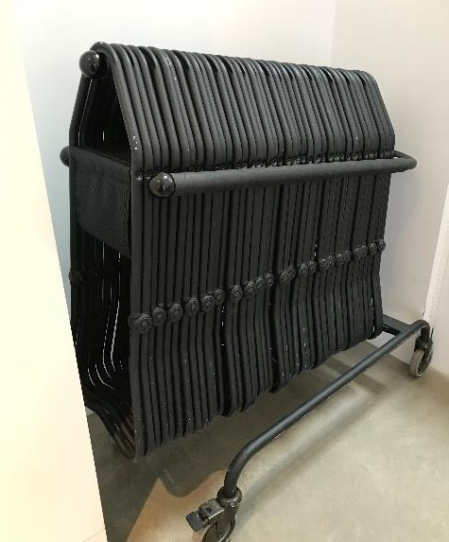
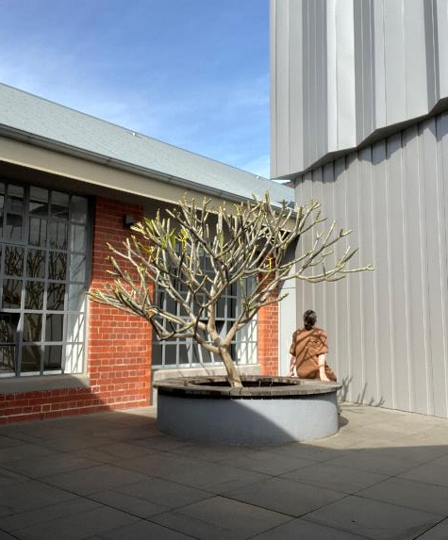
I can ask for a wheelchair to borrow at the front desk if I need one. I can also ask for larger artwork labels so that they're easier to read. There are portable seats at the front desk that I can take with me to sit on throughout Buxton Contemporary.
There are also books next to the front desk that I can buy if I want.
There is a small courtyard to the right of the foyer. If I want to, I can go and sit on a bench in the courtyard.

Slide 8
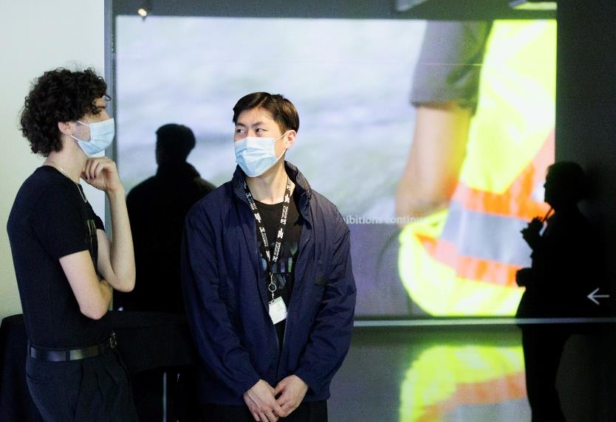
There will be staff members throughout the art museum wearing clothing that says Buxton Contemporary on it.
I can talk them and ask them questions if I want to.

Slide 9
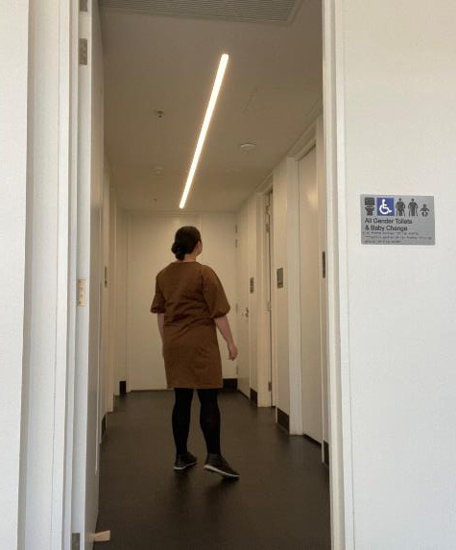
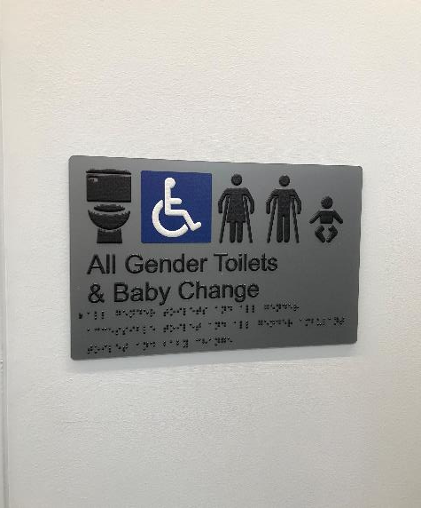
To find the toilets, I will need to go down a corridor to the right of the foyer. Then, I will need to go through a door to my right. Buxton Contemporary have all gender toilets that anyone can use. They also have an accessible toilet.

Slide 10
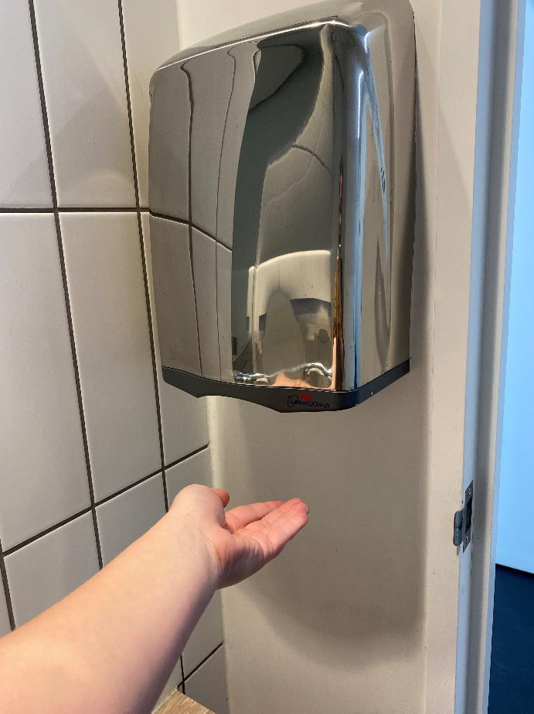
The lights in the toilets are brighter than in the rest of the art museum.
There are also hand dryers in the toilets which can be loud.
Each toilet is in its own room, so the other hand dryers won’t be as loud to me while I’m in a toilet cubicle.

Slide 11
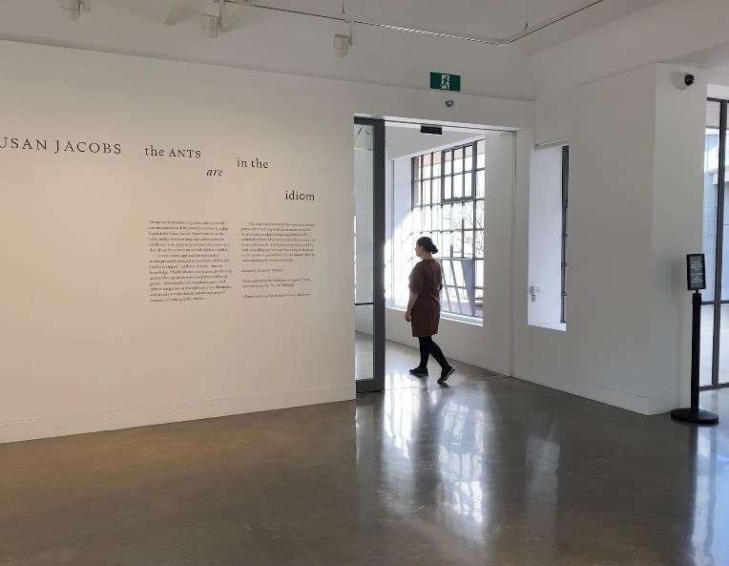
There are doors to the right of the foyer that I can go through to start looking at the art.
There will be small signs by the artworks that I can read to learn more about the art. I will need to look and not touch any of the art.

Slide 12
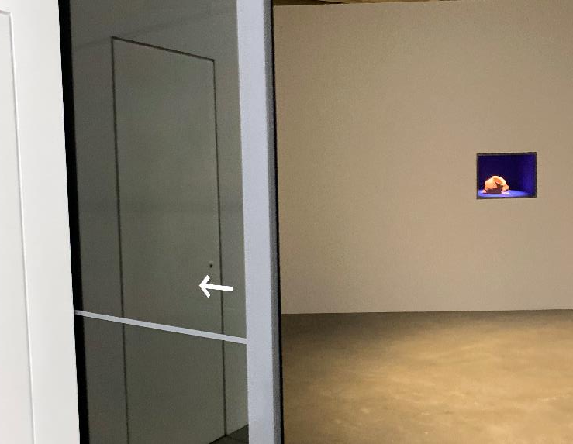
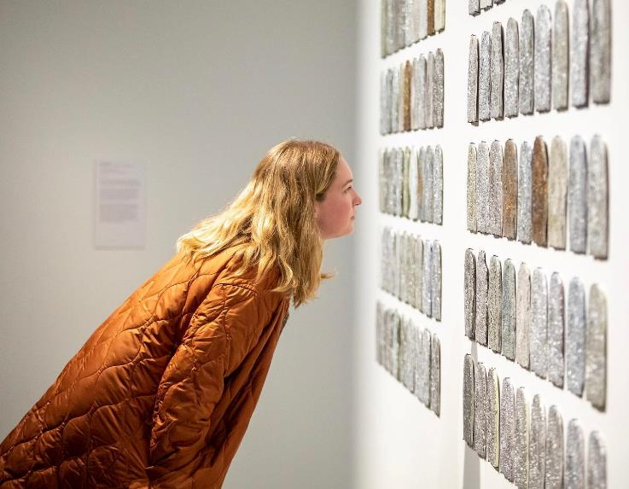
Once I've left the foyer, I will be in the first part of the art museum. There will be art to look at here, as well as in another room straight ahead.
When I'm finished looking at this art, I can go through some doors to the right of the first room. This will take me to the rest of the exhibition.

Slide 13
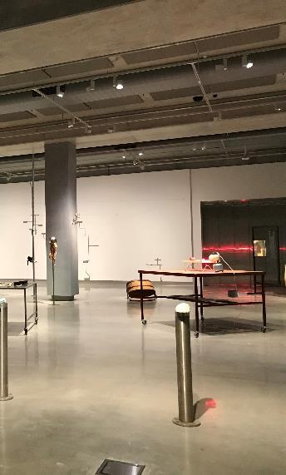
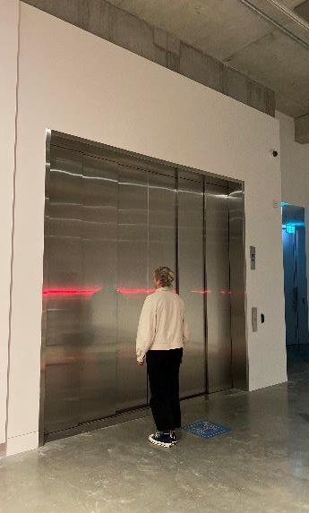
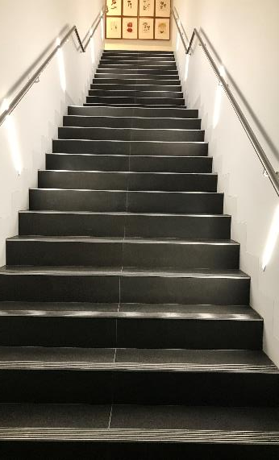
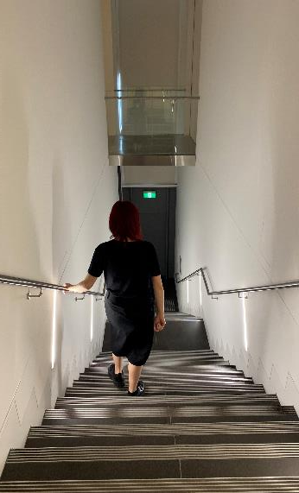
The next room will have more art inside, and a large lift at the back of the room.
There is also a staircase at the back left of the room, which is long and steep. There will be more art upstairs that I can look at once I’m done looking at the art downstairs.
I can either take the lift or the staircase to go upstairs.

Slide 14
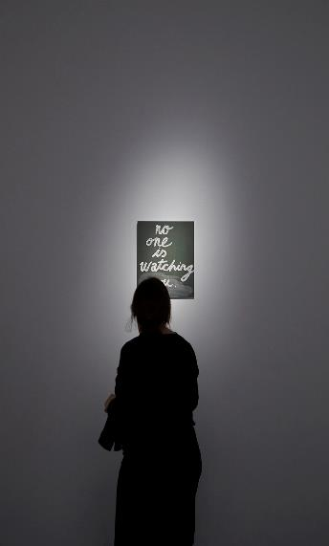
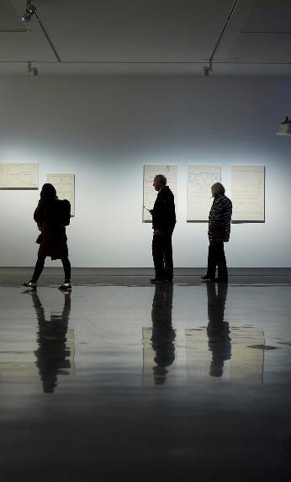
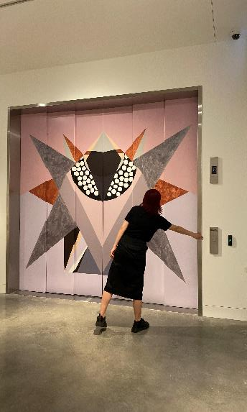
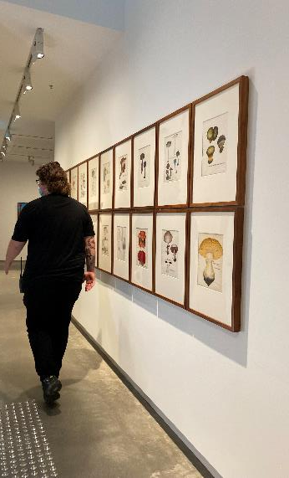
If I take the stairs, I could either go left into a small room, or right into a big room. Both rooms have art in them, and I can visit them both if I want to.
If I take the lift, I will need to use the buttons at the front of the lift, and not the buttons at the back. I can find the small room from the lift by going down a corridor to my right that takes me past the staircase.

Slide 15
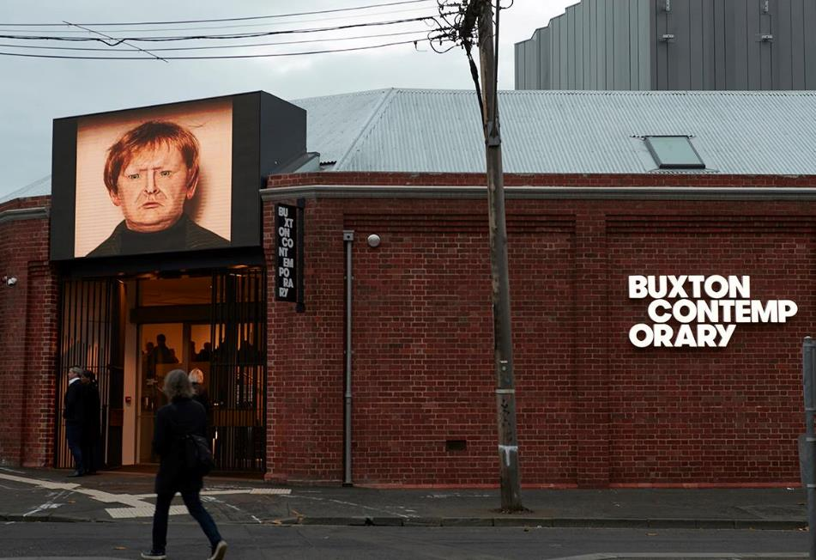
I can stay as long as I want.

Slide 16
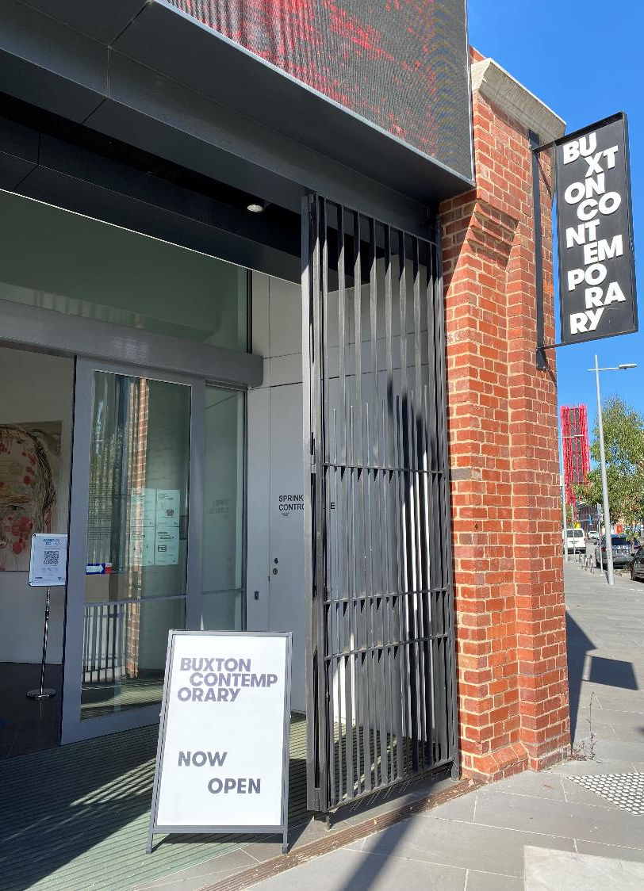
Get in touch:
© Proudly produced by Amaze for Buxton Contemporary
Ground Floor​
678 Victoria Street,​
Richmond VIC 3121 ​
(03) 9657 1600​
info@amaze.org.au​
www.amaze.org.au
Cnr Southbank Boulevard & Dodds Street
Southbank VIC 3006
(03) 9035 9339
buxton-contemporary@unimelb.edu.au
www.buxtoncontemporary.com

